Slide 1
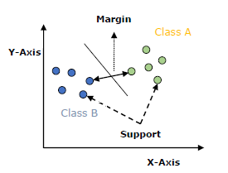
Support Vector Machine
(SVM)

Slide 2
One of the most prevailing and exciting supervised learning models with associated learning algorithms that analyse data and recognise patterns is Support Vector Machines (SVMs).
It is used for solving both regression and classification problems. However, it is mostly used in solving classification problems.

Slide 3
SVMs was first introduced by B.E. Boser et al. in 1992 and has become popular due to success in handwritten digit recognition in 1994.
Before the emergence of Boosting Algorithms for example, XGBoost and AdaBoost, SVMs had been commonly used.

Slide 4
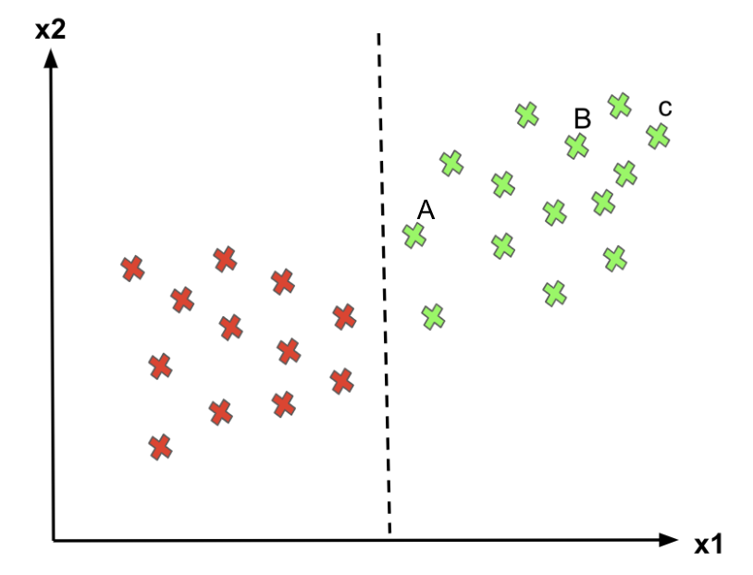
Problem with Logistic Regression
there is an infinite number of decision boundaries, Logistic Regression only picks an arbitrary one.
For point C, since it’s far away from the decision boundary, we are quite certain to classify it as 1.
For point A, even though we classify it as 1 for now, since it is pretty close to the decision boundary, if the boundary moves a little to the right, we would mark point C as “0” instead.
Hence, we’re much more confident about our prediction at A than at C

Slide 5
Problem with Logistic Regression
Logistic Regression doesn’t care whether the instances are close to the decision boundary.
Therefore, the decision boundary it picks may not be optimal.
If a point is far from the decision boundary, we may be more confident in our predictions.
Therefore, the optimal decision boundary should be able to maximize the distance between the decision boundary and all instances. i.e., maximize the margins.
That’s why SVMs algorithm is important!

Slide 6
What is Support Vector Machine (SVM)
Given a set of training examples, each marked as belonging to one or the other of two categories, an SVM training algorithm builds a model that assigns new examples to one category or the other, making it a non-probabilistic binary linear classifier.
The objective of applying SVMs is to find the best line in two dimensions or the best hyperplane in more than two dimensions in order to help us separate our space into classes.
The hyperplane (line) is found through the maximum margin. i.e the maximum distance between data points of both classes.

Slide 7
A Support Vector Machine (SVM) is a discriminative classifier formally defined by a separating hyperplane.
In other words, given labeled training data (supervised learning), the algorithm outputs an optimal hyperplane which categorizes new examples.
In two dimentional space this hyperplane is a line dividing a plane in two parts where in each class lay in either side.

Slide 8
In the SVM algorithm, we plot each data item as a point in n-dimensional space (where n is number of features you have) with the value of each feature being the value of a particular coordinate.
Then, we perform classification by finding the hyper-plane that differentiates the two classes very well.

Slide 9
Support Vector Machines
Imagine the labelled training set are two classes of data points (two dimensions):
To separate the two classes, there are so many possible options of hyperplanes that separate correctly.
We can achieve exactly the same result using different hyperplanes (L1, L2, L3).
However, if we add new data points, the consequence of using various hyperplanes will be very different in terms of classifying new data point into the right group of class.

Slide 10
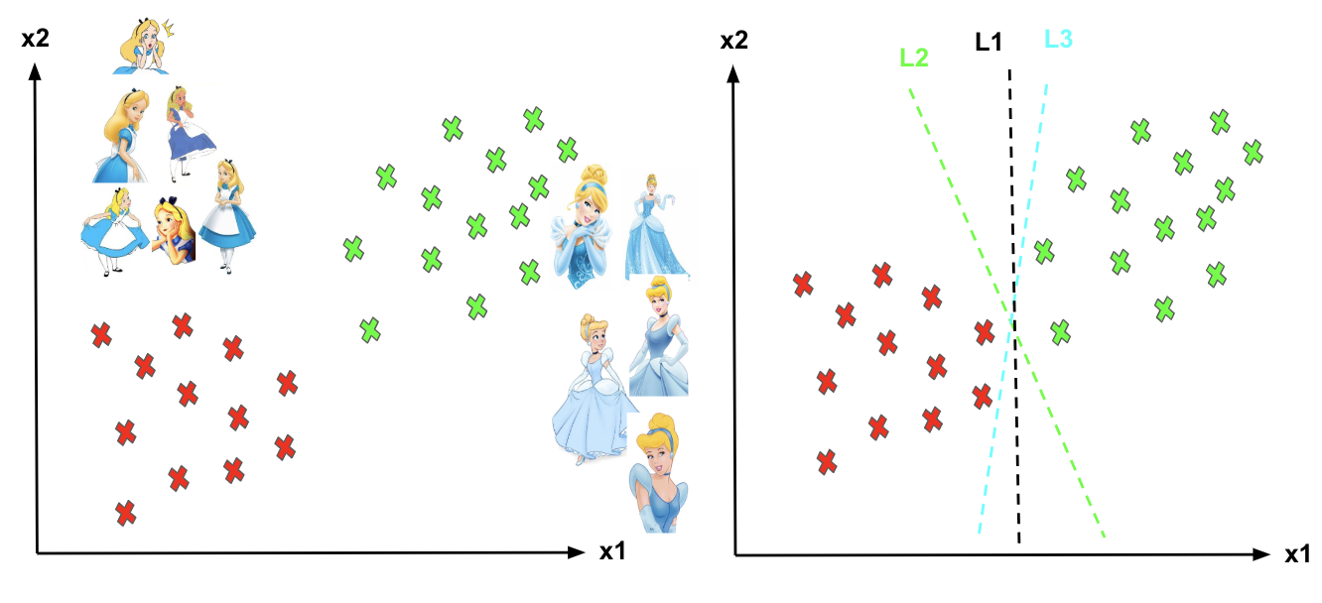

Slide 11
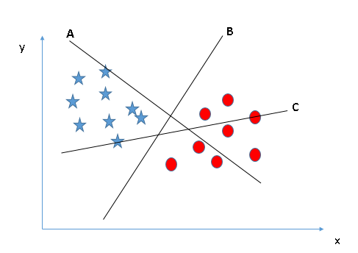
Identify the right hyper-plane (Scenario-1):
Here, we have three hyper-planes (A, B and C). Now, identify the right hyper-plane to classify star and circle.
You need to remember a thumb rule to identify the right hyper-plane: “Select the hyper-plane which segregates the two classes better”. In this scenario, hyper-plane “B” has excellently performed this job.

Slide 12
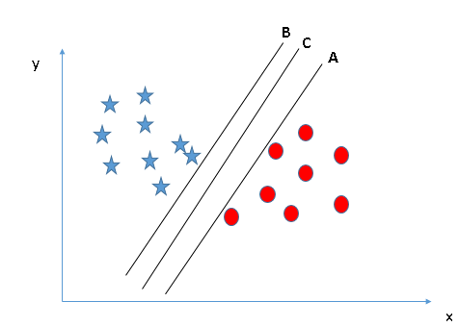
Identify the right hyper-plane (Scenario-2):
Here, we have three hyper-planes (A, B and C) and all are segregating the classes well. Now, How can we identify the right hyper-plane?
Here, maximizing the distances between nearest data point (either class) and hyper-plane will help us to decide the right hyper-plane. This distance is called as Margin. Let’s look at the next figure:

Slide 13
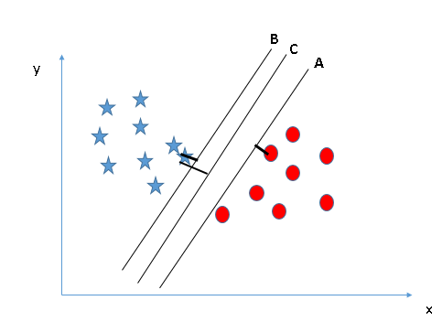
Above, you can see that the margin for hyper-plane C is high as compared to both A and B. Hence, we name the right hyper-plane as C. Another lightning reason for selecting the hyper-plane with higher margin is robustness. If we select a hyper-plane having low margin then there is high chance of miss-classification.

Slide 14
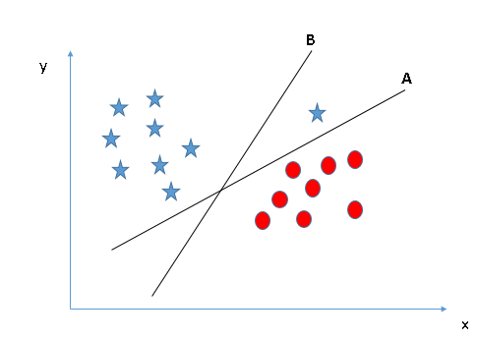
Identify the right hyper-plane (Scenario-3):
The hyper-plane B seems a good choice here as it has higher margin compared to A. But, here is the catch, SVM selects the hyper-plane which classifies the classes accurately prior to maximizing margin.
Here, hyper-plane B has a classification error and A has classified all correctly. Therefore, the right hyper-plane is A.

Slide 15
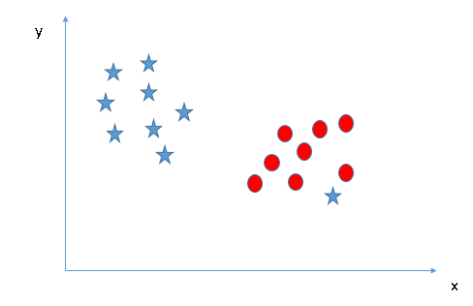
Can we classify two classes (Scenario-4)?:
Below, I am unable to segregate the two classes using a straight line, as one of the stars lies in the territory of other(circle) class as an outlier.

Slide 16
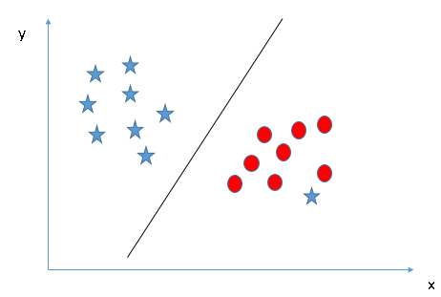
As I have already mentioned, one star at other end is like an outlier for star class. The SVM algorithm has a feature to ignore outliers and find the hyper-plane that has the maximum margin. Hence, we can say, SVM classification is robust to outliers.

Slide 17
support vector points
The vector points closest to the hyperplane are known as the support vector points because only these two points are contributing to the result of the algorithm, other points are not.
If a data point is not a support vector, removing it has no effect on the model.
On the other hands, deleting the support vectors will then change the position of the hyperplane.

Slide 18
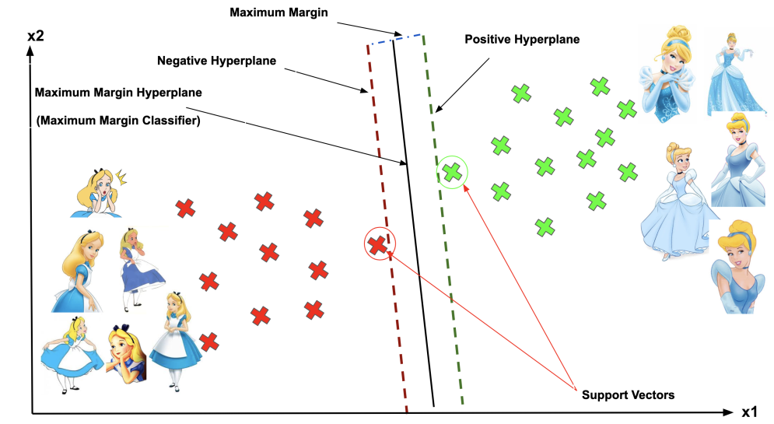

Slide 19
hyperplane
The dimension of the hyperplane depends upon the number of features.
If the number of input features is 2, then the hyperplane is just a line.
If the number of input features is 3, then the hyperplane becomes a two-dimensional plane.
It becomes difficult to imagine when the number of features exceeds 3.

Slide 20
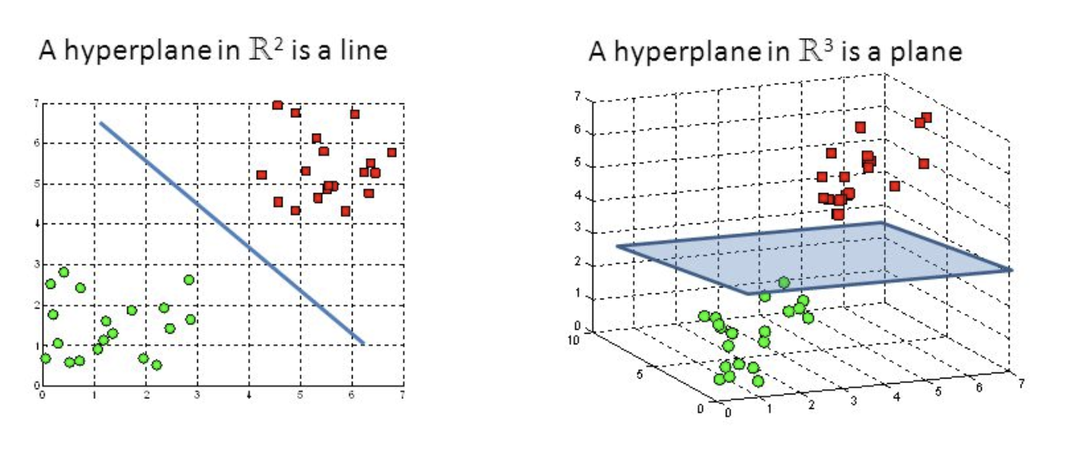

Slide 21
margin
The distance of the vectors from the hyperplane is called the margin which is a separation of a line to the closest class points.
We would like to choose a hyperplane that maximises the margin between classes.
The graph in next slide shows what good margin and bad margin are.

Slide 22
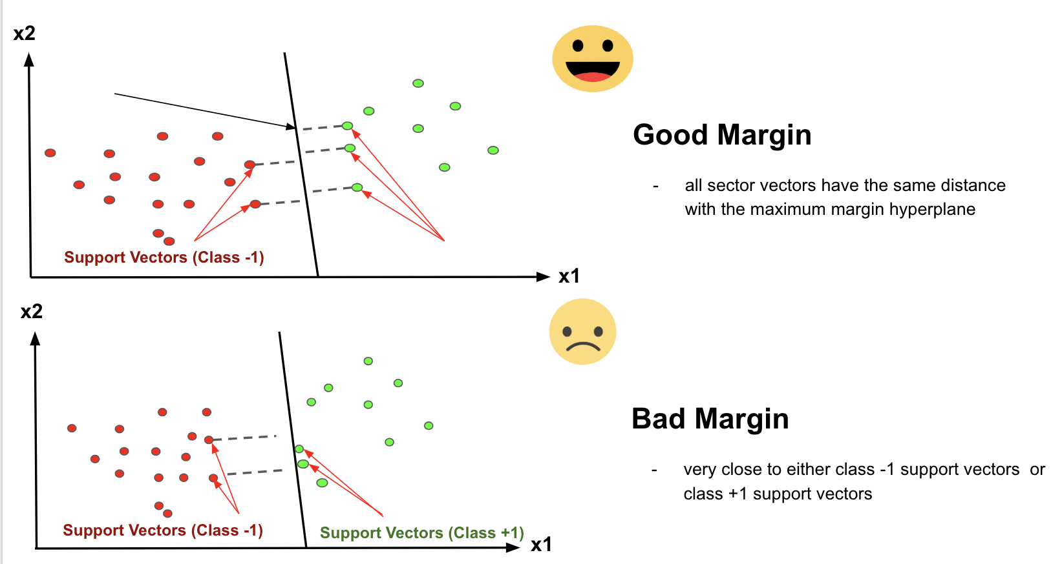

Slide 23
Hard Margin
  If the training data is linearly separable, we can select two parallel hyperplanes that separate the two classes of data, so that the distance between them is as large as possible.
Soft Margin
  As most of the real-world data are not fully linearly separable, we will allow some margin violation to occur which is called soft margin classification. It is better to have a large margin, even though some constraints are violated. Margin violation means choosing a hyperplane, which can allow some data points to stay in either incorrect side of hyperplane and between margin and correct side of the hyperplane.

Slide 24
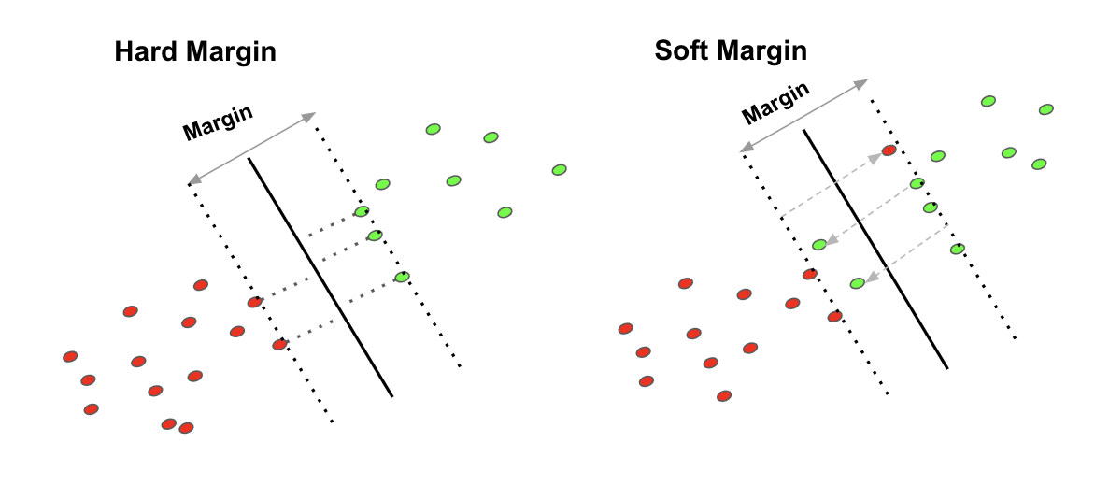

Slide 25
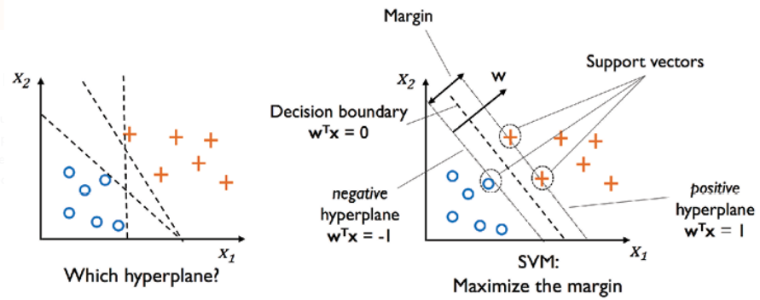
Maximum margin hyperplane

Slide 26
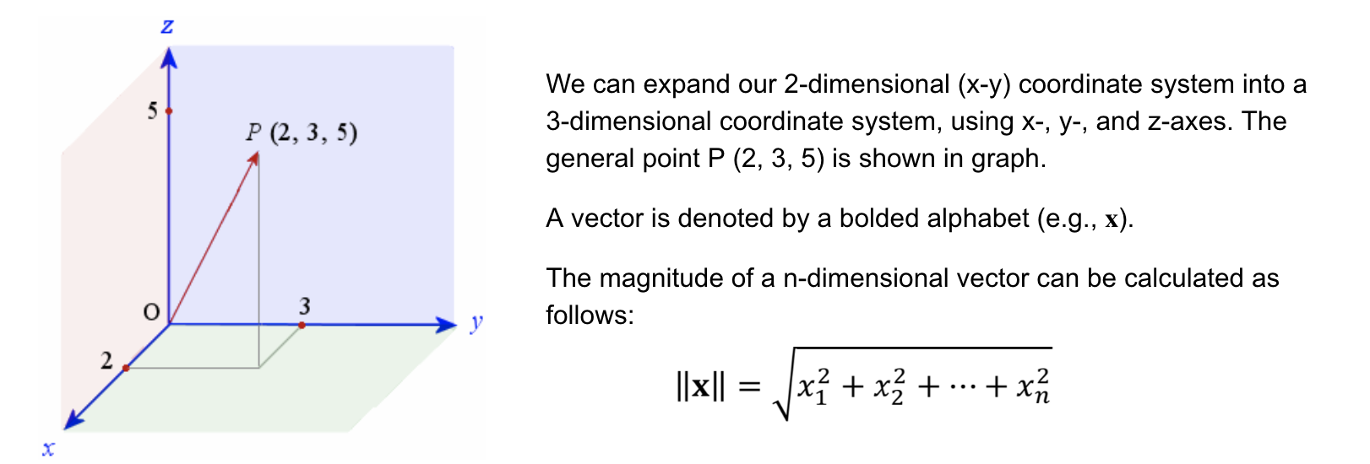
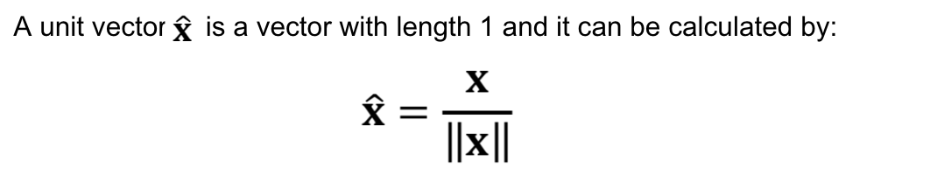
Linear Algebra Revisited

Slide 27
Maximising the Margin
For Support Vector Classifier (SVC), we use 𝐰T𝐱+𝑏 where 𝐰 is the weight vector and 𝑏 is the bias.

Slide 28
The name of the variables in the hyperplane equation are w and x which means they are vectors!
A vector has magnitude (size) and direction which works perfectly well in 3 or more dimensions.
Therefore, the application of “vector” is used in the SVMs algorithm.

Slide 29
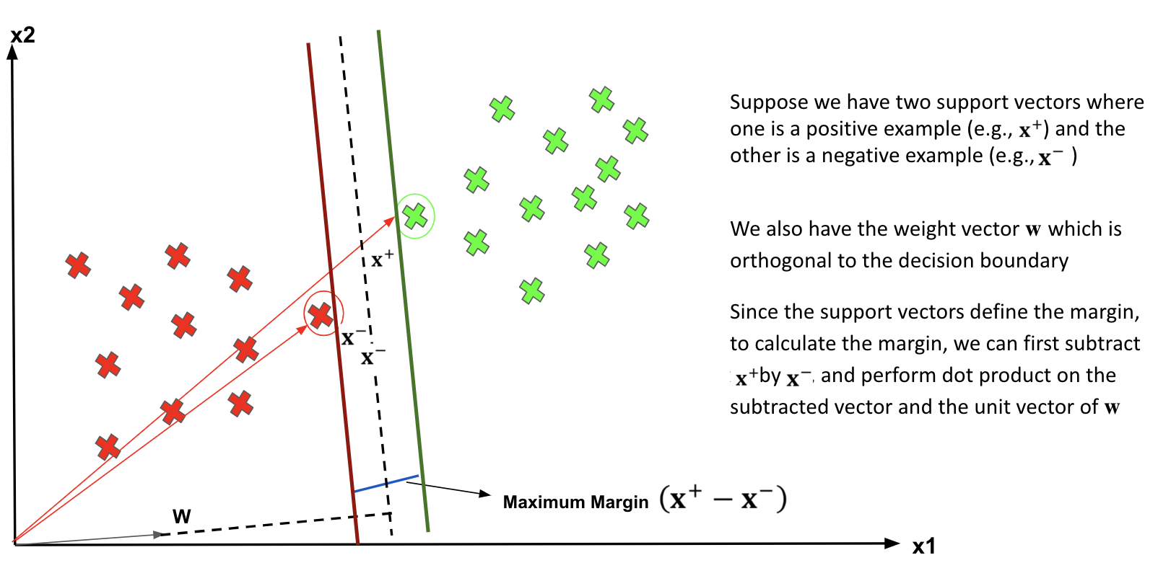
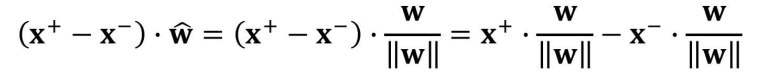
the equation of calculating the Margin

Slide 30
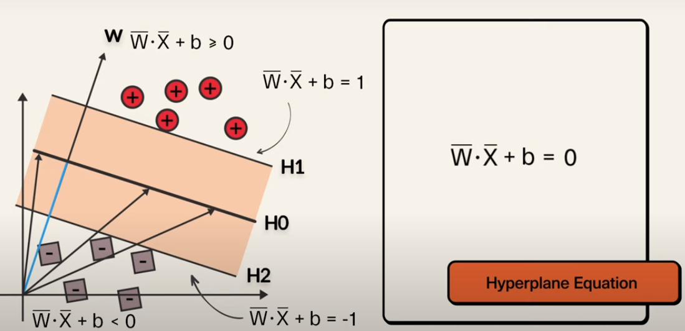

Slide 31
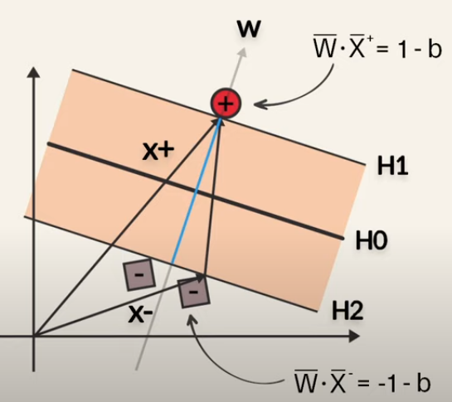

Slide 32
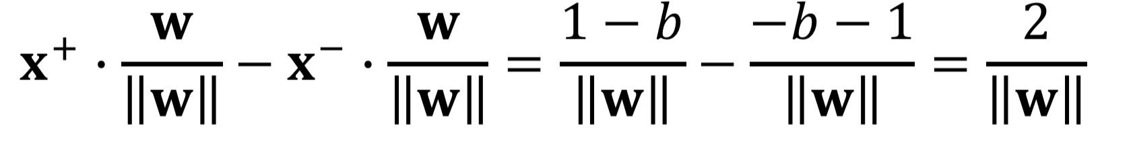
Note that 𝑦i is either +1 or -1Therefore, we have:

Slide 33
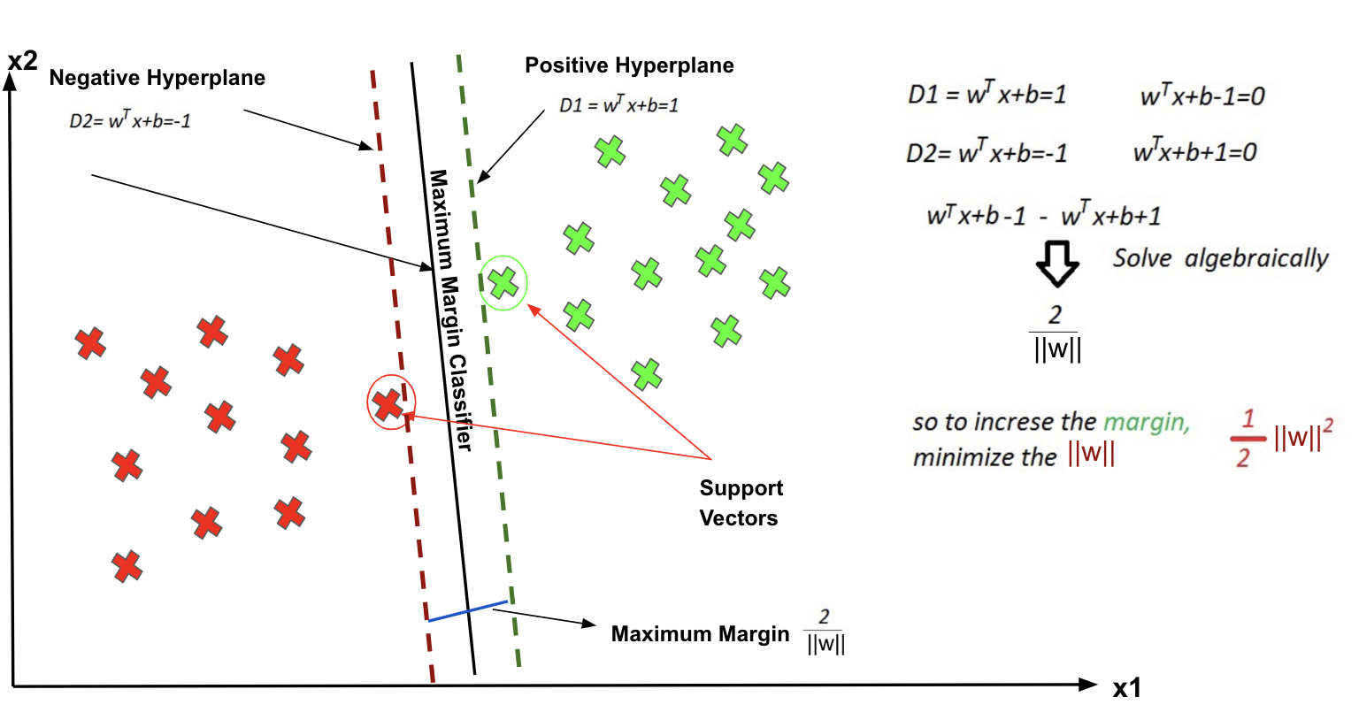

Slide 34
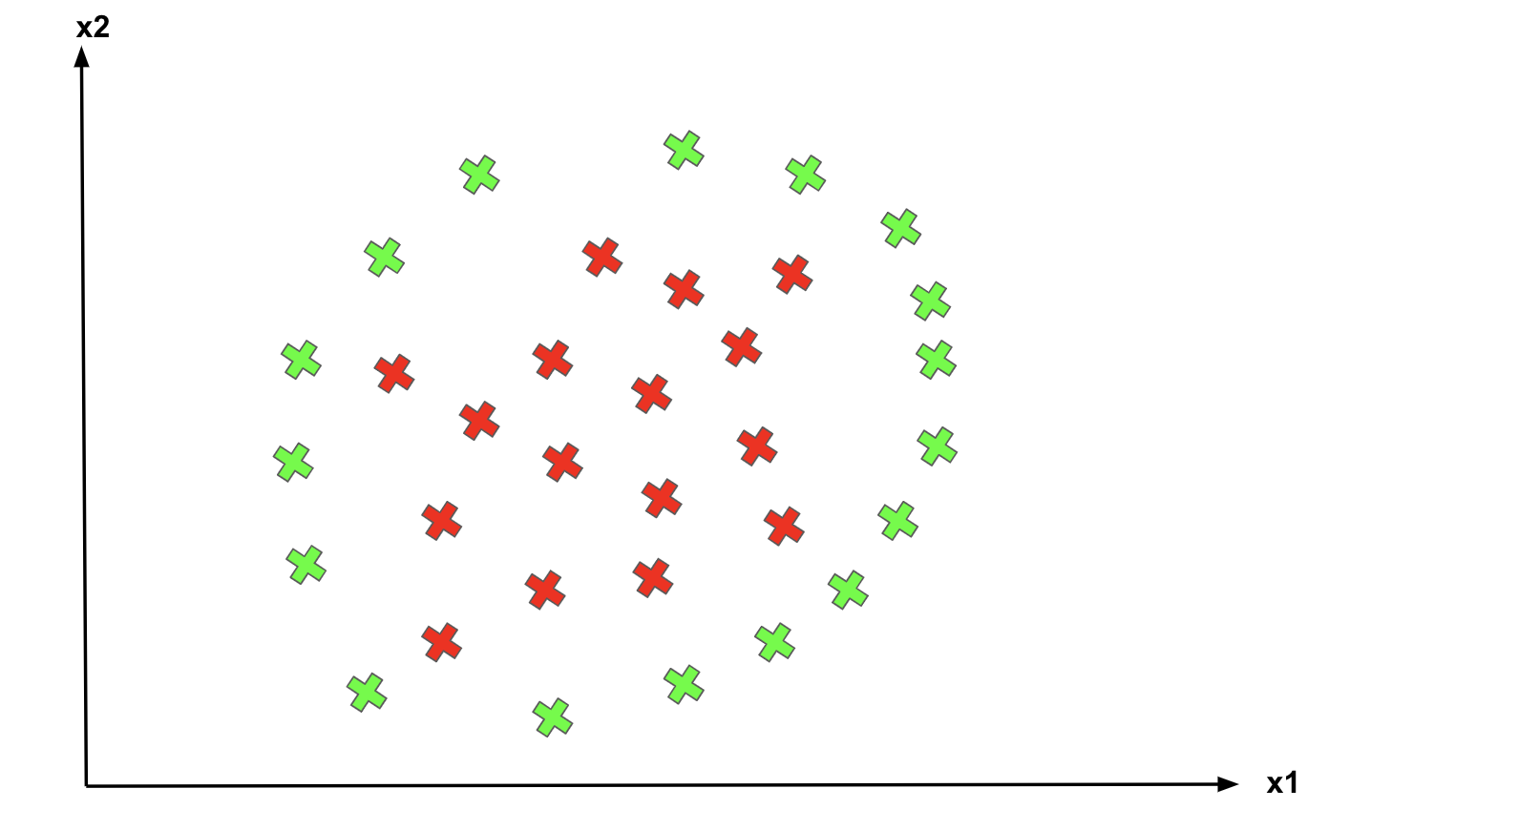
Classifying non-linear data
What about data points are not linearly separable?

Slide 35
non-linear separate
SVM has a technique called the kernel trick.
These are functions which take low dimensional input space and transform it into a higher-dimensional space i.e. it converts not separable problem to separable problem.
It is mostly useful in non-linear separation problem.

Slide 36
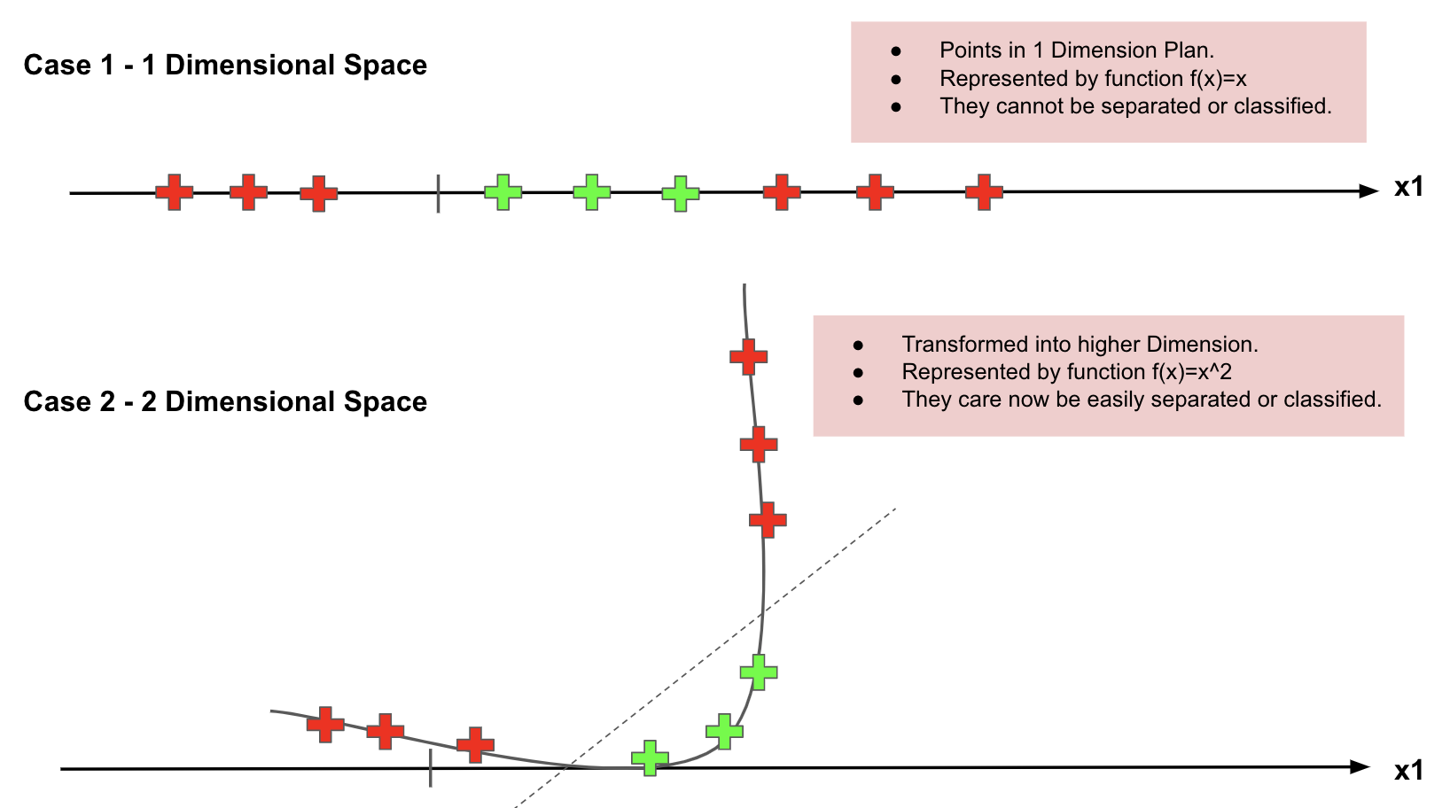

Slide 37
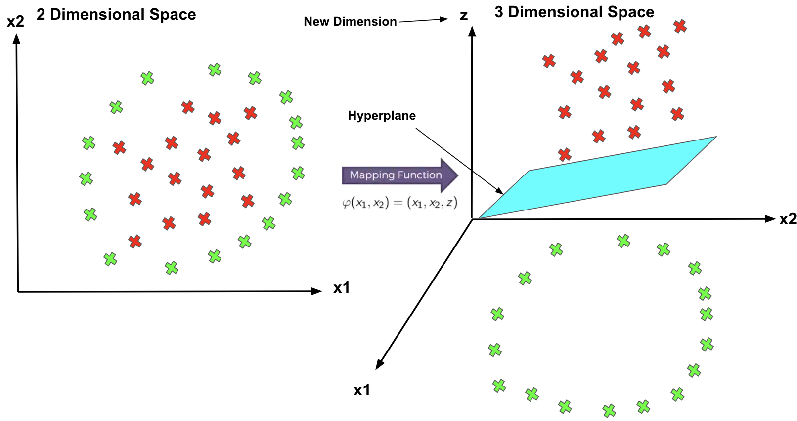

Slide 38
SVM Kernels
In practice, SVM algorithm is implemented with kernel that transforms an input data space into the required form.
SVM uses a technique called the kernel trick in which kernel takes a low dimensional input space and transforms it into a higher dimensional space.
In simple words, kernel converts non-separable problems into separable problems by adding more dimensions to it.
It makes SVM more powerful, flexible and accurate.

Slide 39
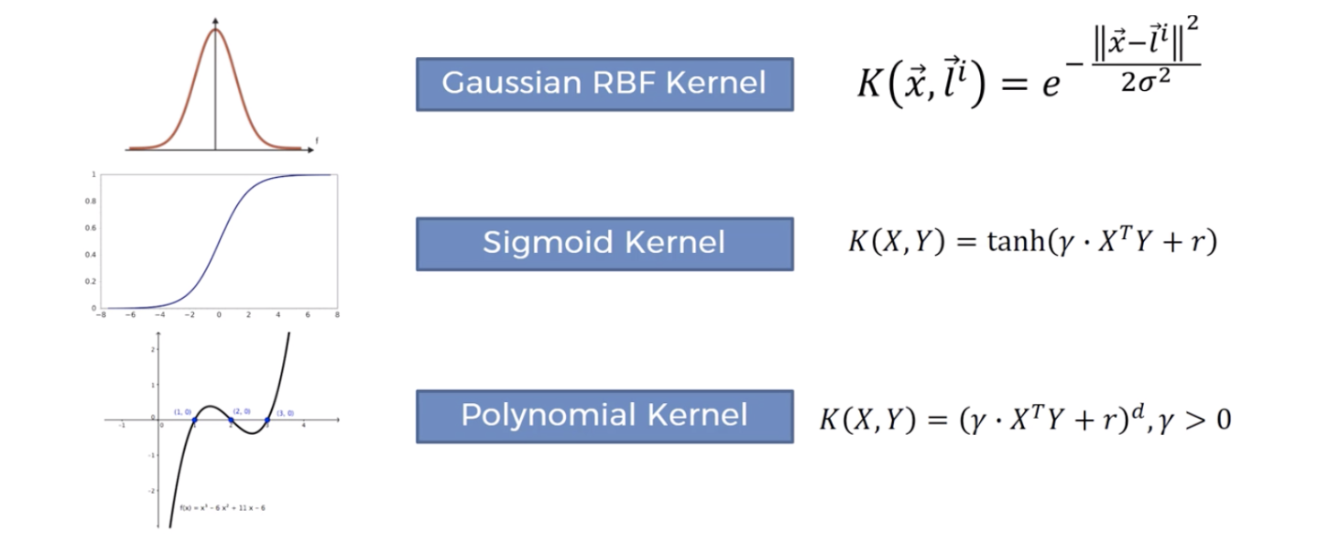
Some Frequently Used Kernels

Slide 40

Linear Kernel
It can be used as a dot product between any two observations. The formula of linear kernel is as below −
From the above formula, we can see that the product between two vectors say 𝑥 & 𝑥𝑖 is the sum of the multiplication of each pair of input values.

Slide 41

Polynomial Kernel
It is more generalized form of linear kernel and distinguish curved or nonlinear input space.
Following is the formula for polynomial kernel −
Here d is the degree of polynomial, which we need to specify manually in the learning algorithm.

Slide 42
Radial Basis Function (RBF) Kernel
RBF kernel, mostly used in SVM classification, maps input space in indefinite dimensional space.
Following formula explains it mathematically −
Here, gamma ranges from 0 to 1. We need to manually specify it in the learning algorithm. A good default value of gamma is 0.1.
As we implemented SVM for linearly separable data, we can implement it in Python for the data that is not linearly separable. It can be done by using kernels.

Slide 43
Tuning parameters: Kernel, Regularization, Gamma and Margin.
These are tuning parameters in SVM classifier.
Varying those we can achive considerable non linear classification line with more accuracy in reasonable amount of time.

Slide 44
Regularization
The Regularization parameter (often termed as C parameter ) tells the SVM optimization how much you want to avoid misclassifying each training example.
For large values of C, the optimization will choose a smaller-margin hyperplane if that hyperplane does a better job of getting all the training points classified correctly.
Conversely, a very small value of C will cause the optimizer to look for a larger-margin separating hyperplane, even if that hyperplane misclassifies more points.

Slide 45
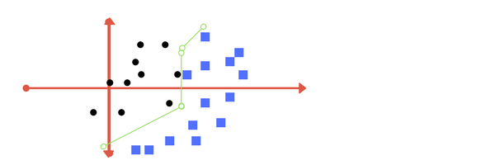
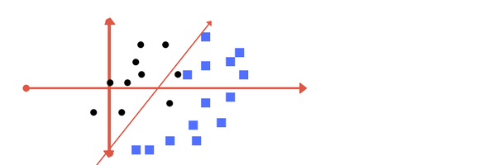
The images below are example of two different regularization parameter.
Left one has some misclassification due to lower regularization value.
Higher value leads to results like right one.

Slide 46
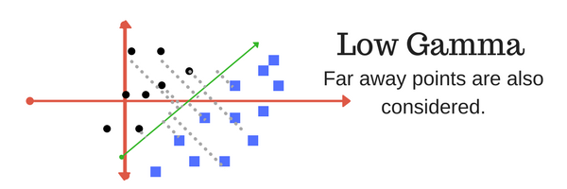
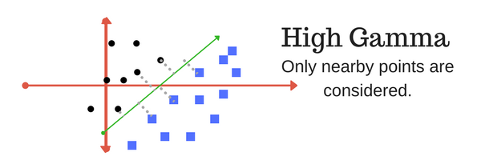
Gamma
The gamma parameter defines how far the influence of a single training example reaches, with low values meaning ‘far’ and high values meaning ‘close’.
In other words, with low gamma, points far away from plausible separation line are considered in calculation for the separation line. Where as high gamma means the points close to plausible line are considered in calculation.

Slide 47
Why SVMs
Solve the data points are not linearly separable
Effective in a higher dimension.
Suitable for small data set: effective when the number of features is more than training examples.
Overfitting problem:
  The hyperplane is affected by only the support vectors thus SVMs are not robust to the outliner.

Slide 48
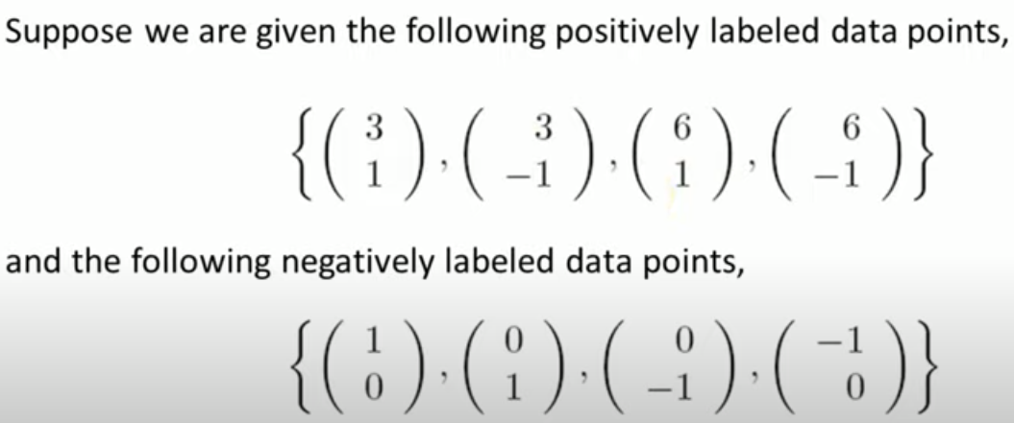
Linear Solved Example

Slide 49
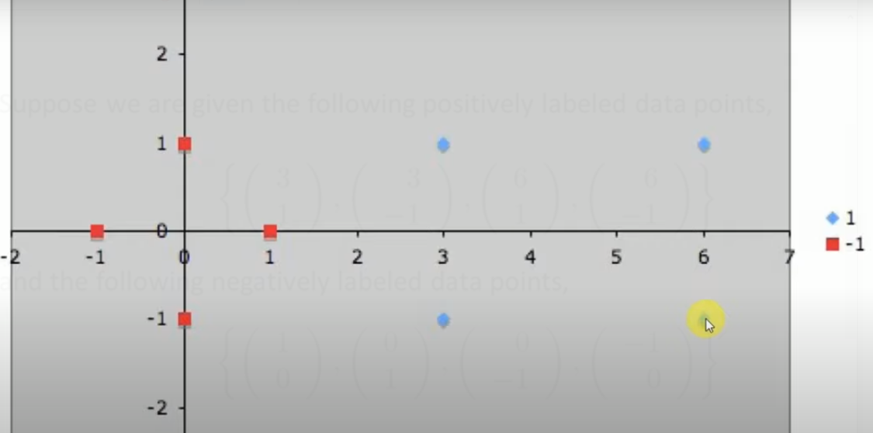
Linear Solved Example

Slide 50
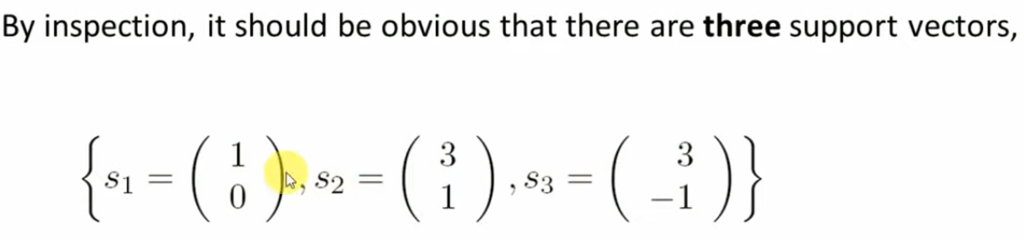
Linear Solved Example

Slide 51
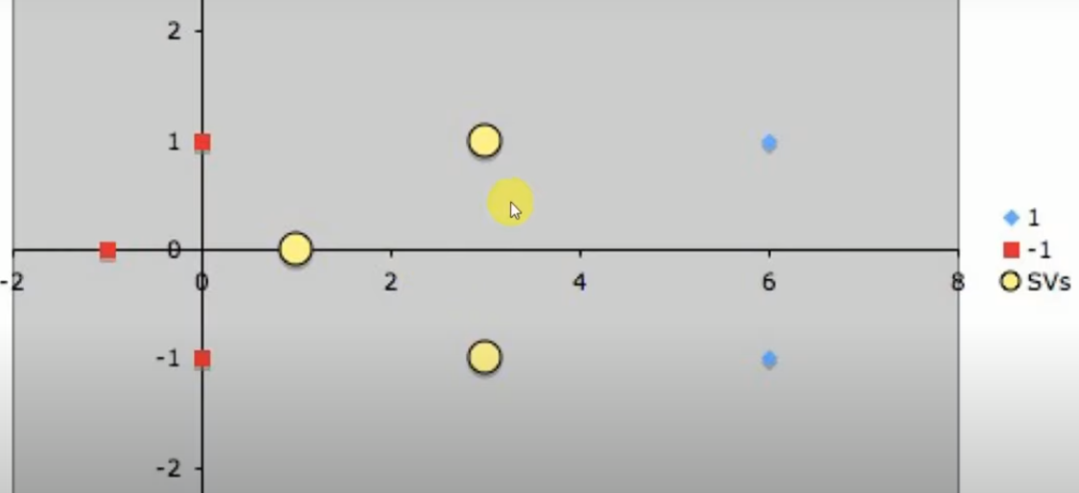
Linear Solved Example

Slide 52
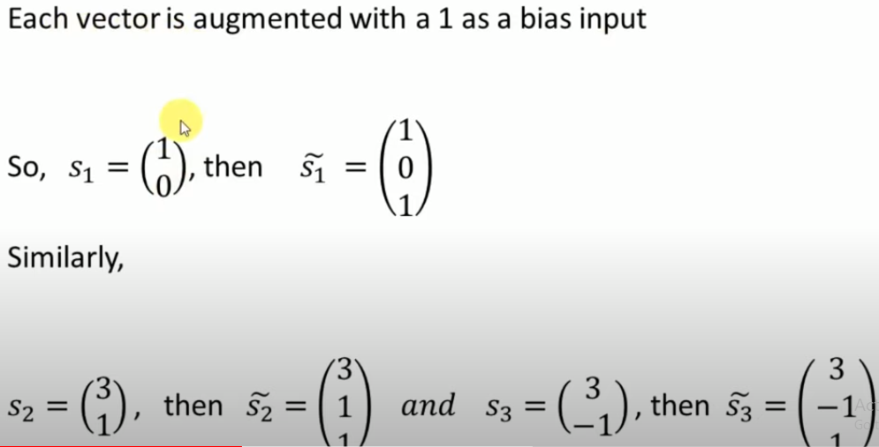
Linear Solved Example

Slide 53
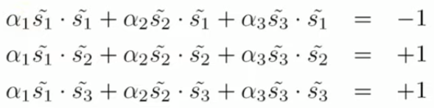
Linear Solved Example

Slide 54
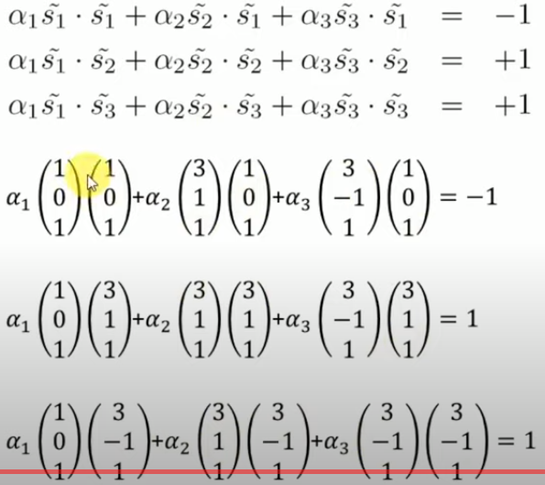
Linear Solved Example

Slide 55
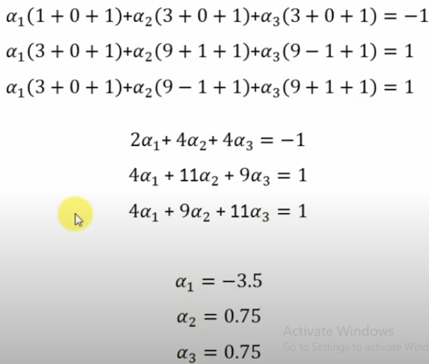
Linear Solved Example

Slide 56
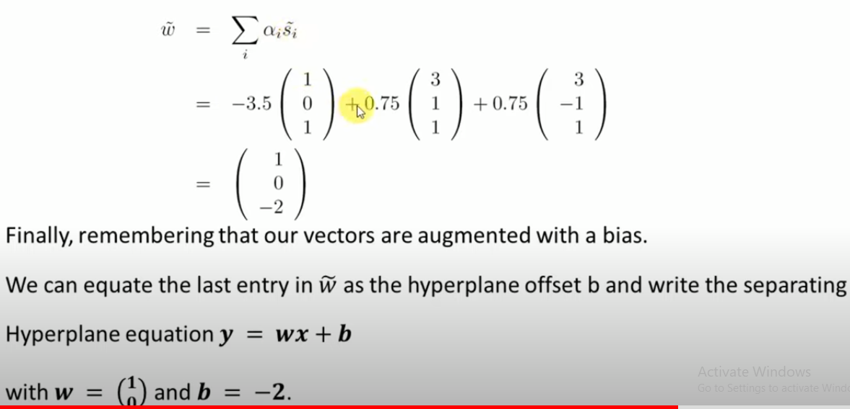
Linear Solved Example
Boundary will be perpendicular to y axis

Slide 57
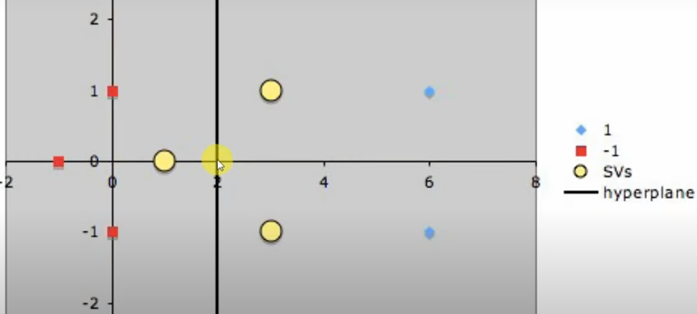
Linear Solved Example

Slide 58
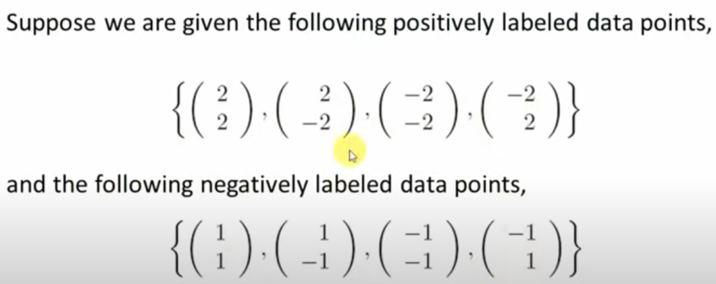
Non-Linear Solved Example

Slide 59
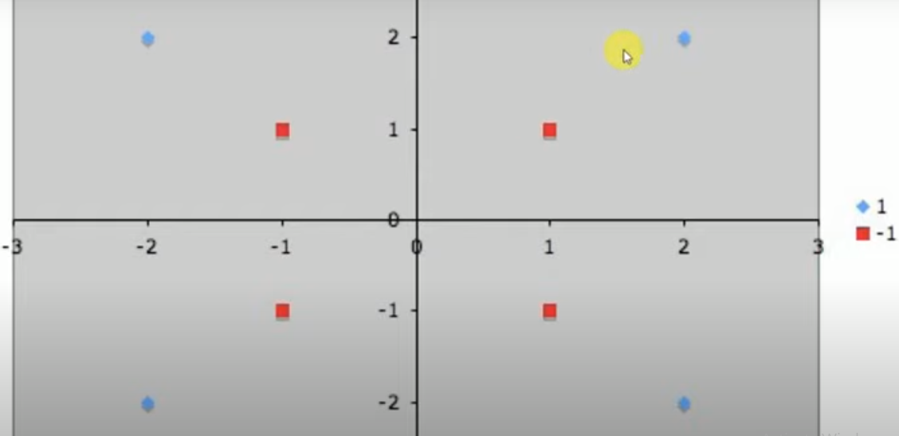
Non-Linear Solved Example

Slide 60
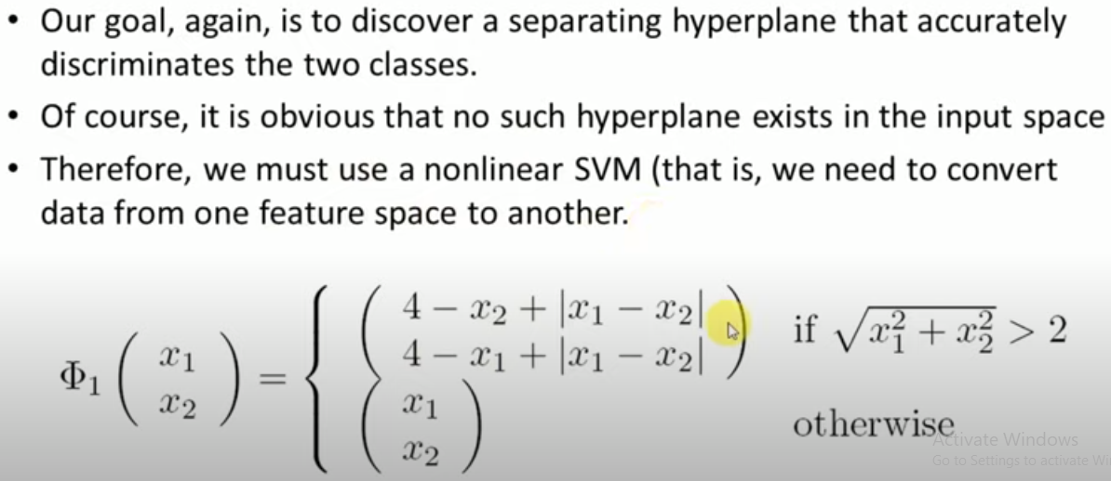
Non-Linear Solved Example

Slide 61
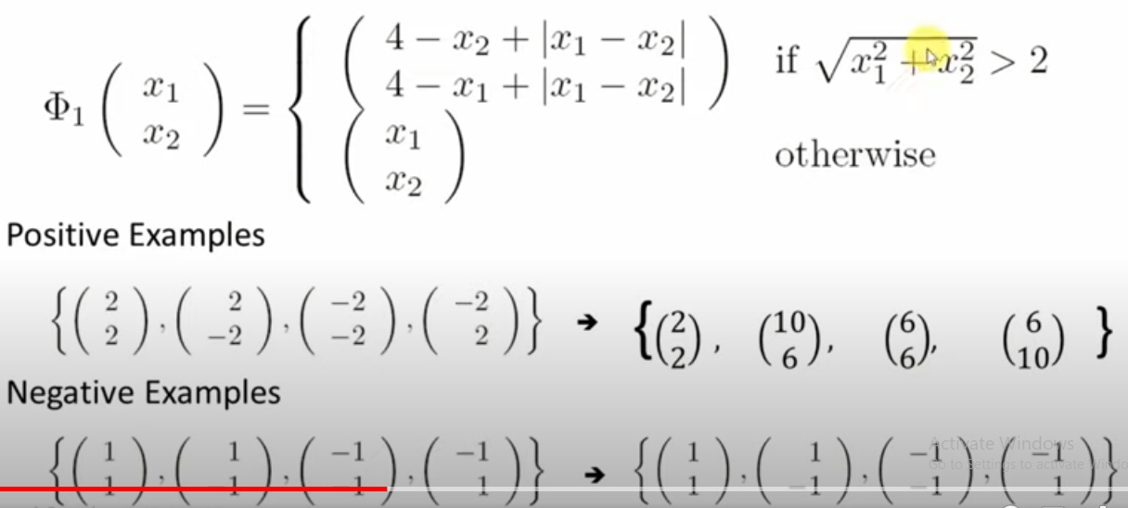
Non-Linear Solved Example

Slide 62
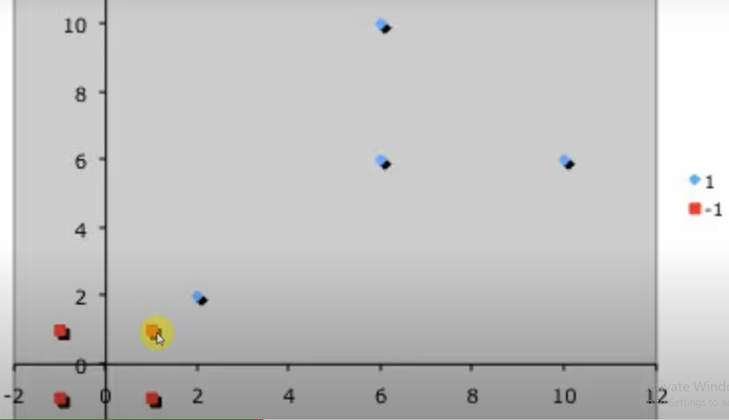
Non-Linear Solved Example

Slide 63
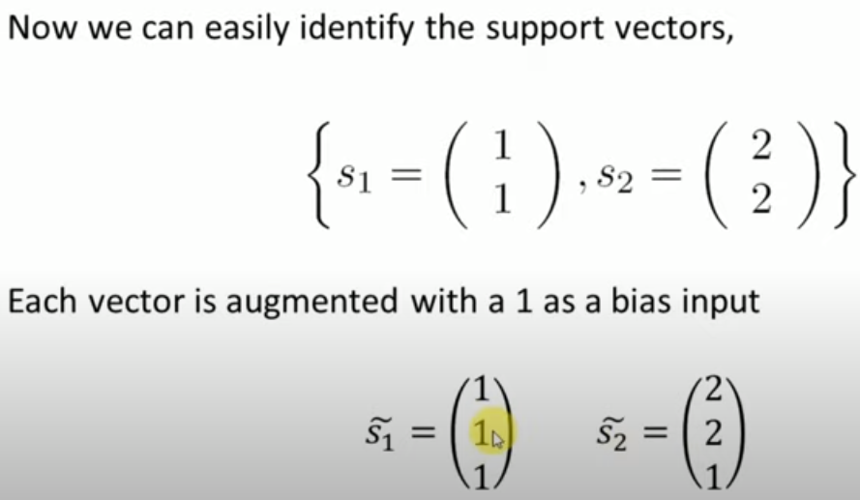
Non-Linear Solved Example

Slide 64
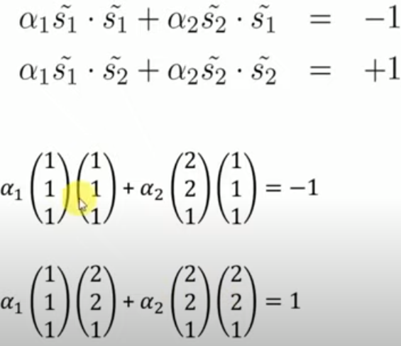
Non-Linear Solved Example

Slide 65
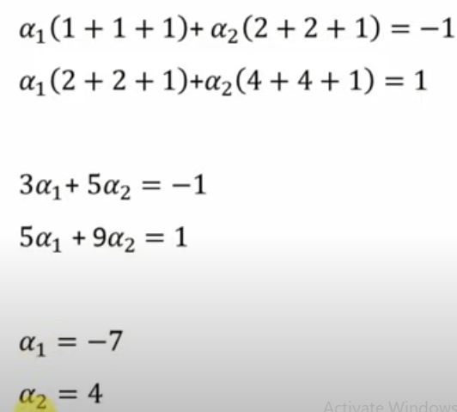
Non-Linear Solved Example

Slide 66
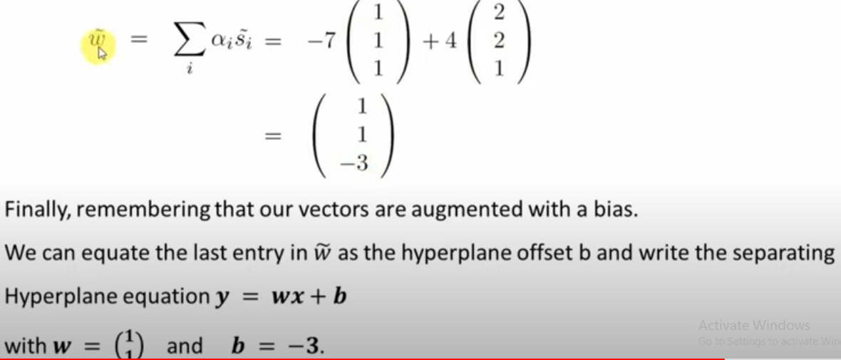
Non-Linear Solved Example

Slide 67
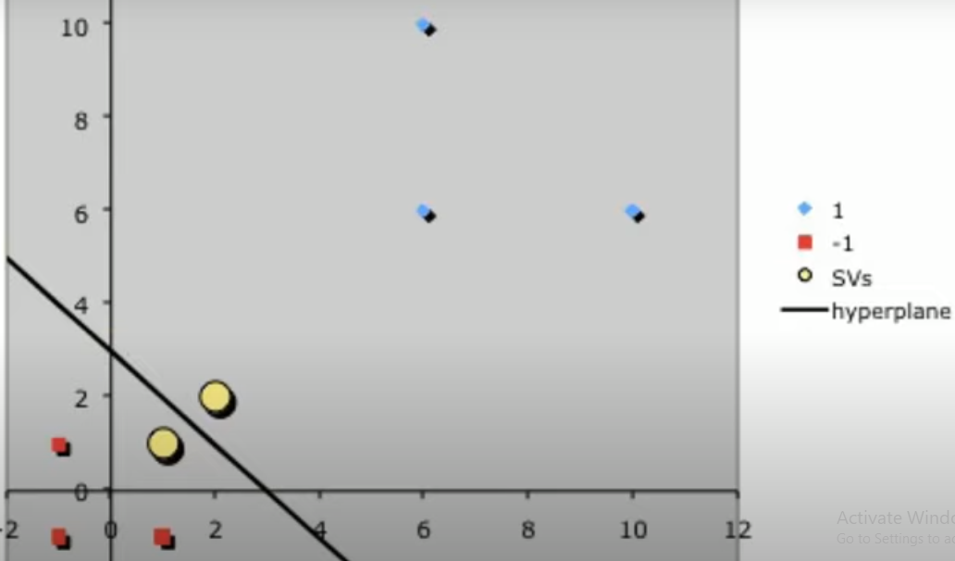
Non-Linear Solved Example

